Slide 1
SIT102 - Introduction to Computer Programming
Introduction to Computer Programming

Slide 2
Computer Systems: Hardware and Software
Computer Systems Consist of Similar Hardware Devices and Components
Computer Hardware
Refers to the physical components
Not one device but a system of many devices
Major types of components include:
Central Processing Unit
Main memory
Secondary storage devices
Input devices
Output devices

Slide 3
Organization of a Computer System
Central
Processing
Unit
Input
Device
Output
Device
Main
Memory
Secondary
Storage

Slide 4
The CPU
Fetches instructions from main memory
Carries out the operations commanded by the instructions
Each instruction produces some outcome
CPU gets instructions from a program
A program is an entire sequence of instructions
Instructions are stored as binary numbers
Binary number - a sequence of 1’s and 0’s

Slide 5
Main Memory
Commonly known as random access memory, or just RAM
Holds instructions and data needed for programs that are currently running
RAM is usually a volatile type of memory
Contents are lost when power is turned off
Used as temporary storage

Slide 6
Secondary Storage
A nonvolatile storage medium
Contents retained while power is off
Hard disk drives are most common
Records data magnetically on a circular disk
Provides fast access to large amounts of data
Optical devices store data on CD’s as pits
USB flash memory devices
High capacity device plugs into USB port
Portable, reliable, and fits easily in a pocket

Slide 7
Input Devices
Any type of device that provides data to a computer from the outside world
For example:
Keyboard
Mouse
Scanner

Slide 8
Output Devices
Any type of device that provides data from a computer to the outside world
Examples of output data:
A printed report
An image such as a picture
A sound
Common output devices include:
Monitor (display screen)
Printer

Slide 9
Software
The programs that run on a computer
Two major categories
Operating systems
Controls the processes within the computer
Manages the computer's hardware devices
Application Software
Solve problems or perform tasks needed by users
Examples include word processing, spreadsheets, games, Internet browsers, playing music, etc)
Each program is referred to as an application
This unit develops applications in C#

Slide 10
Programs and Programming Languages
What is a program?
Computers can only follow instructions
A computer program is a set of instructions on how to solve a problem or perform a task in a selected programming language
In order for a computer to compute someone’s gross pay, we must tell it to perform the steps on the following slide

Slide 11
Computing Gross Pay
Display message: "How many hours did you work?"
Allow user to enter number of hours worked
Store the number the user enters in memory
Display message: "How much are you paid per hour?"
Allow the user to enter an hourly pay rate
Store the number the user enters in memory
Multiply hours worked by pay rate and store the result in memory
Display a message with the result of the previous step
This well-defined, ordered set of steps for solving a problem is called an algorithm

Slide 12
States and Transitions
Memory shows states of the program
Store hours worked in memory
Store hourly pay rate in memory
Multiply hours worked by pay rate and store amount earned in memory
Program Starting State
hours worked | ??
hourly pay rate | ??
amount earned | ??
Snapshot after Step 3
hours worked | 36
hourly pay rate | ??
amount earned | ??
Snapshot after Step 6
hours worked | 36
hourly pay rate | 20
amount earned | ??
Snapshot after Step 7
hours worked | 36
hourly pay rate | 20
amount earned | 720

Slide 13
Programming Languages
The steps in our algorithm must be stated in a form the computer understands
The CPU processes instructions as a series of 1’s and 0’s called machine language
This is a tedious and difficult format for people
A programming language is a special language used to write computer programs
Instead, programming languages allow us to use words instead of numbers
Software converts the programming language statements to machine language

Slide 14
Common Programming Languages
C#
C
C++
PHP
Visual Basic
Python
Javascript
Java
Visual C# is not just a programming language
It’s a programming environment with tools to:
Create screen elements (in GUI Later)
Write programming language statements
Down load
http://www.deakin.edu.au/software/course.php?anchor=vsexpress

Slide 15
Methods of Programming
Function / Procedural / Operation
Constructed as a set of procedures (operational, functional units)
Each procedure is a set of instructions
The Gross Pay computation is a procedure
Object-Oriented
Uses real-world objects such as students, transcripts, and courses
Objects have data elements called attributes data
Objects also perform actions

Slide 16
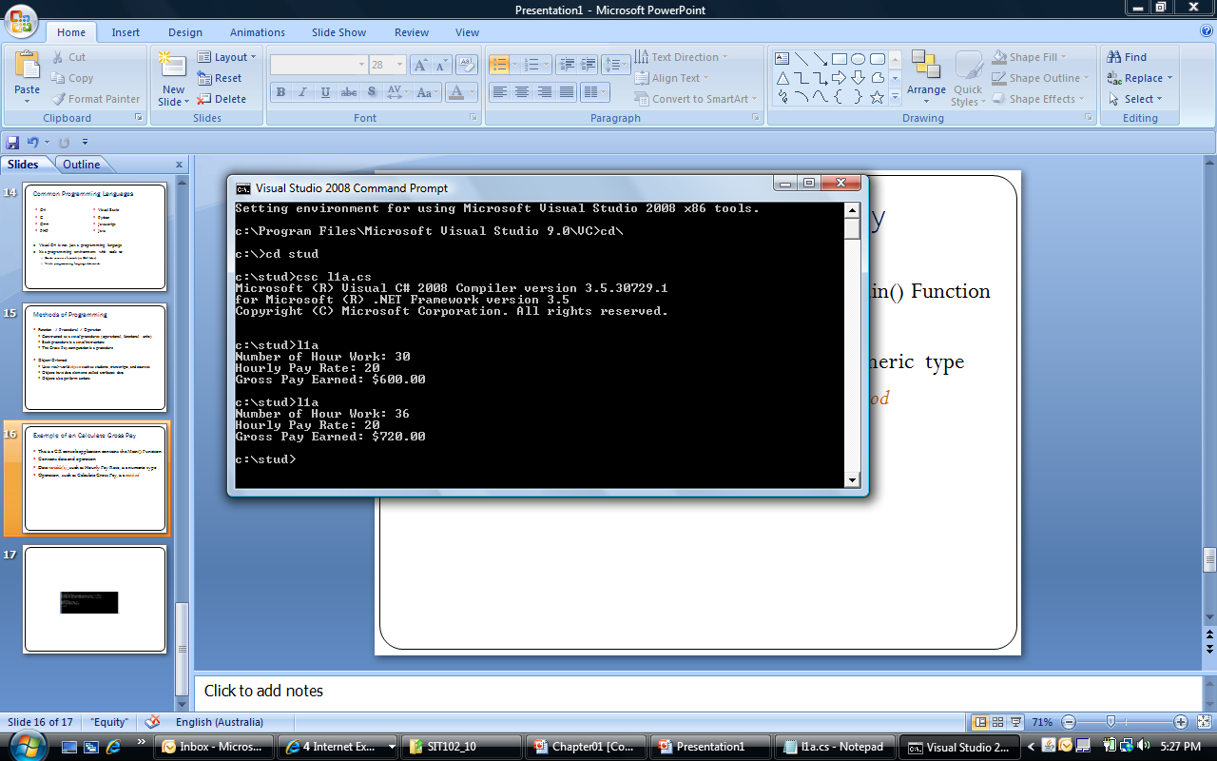
Example of an Calculate Gross Pay
This is a C# console application contains the Main() Function
Contains data and operation
Data variable(s), such as Hourly Pay Rate, is a numeric type
Operation, such as Calculate Gross Pay, is a method

Slide 17
Program– Compute Gross Pay
using System;
public class CalculateGrossPay
{
public static void Main()
{ // Declare data variables
int Hour = 0;
decimal PayRate = 0M, GrossPay = 0M;
// get hour work
Console.Write("Number of Hour Work: ");
Hour = Convert.ToInt32(Console.ReadLine());
// get pay rate
Console.Write("Hourly Pay Rate: ");
PayRate = Convert.ToDecimal(Console.ReadLine());
GrossPay = Hour * PayRate; // calculate the payment
Console.WriteLine("Gross Pay Earned: " +GrossPay.ToString("c"));
// display the payment
}
}

Slide 18
Language Elements
Keywords: Words with special meaning to C# (e.g., public, class, static, void)
Programmer-defined-names: Names created by the programmer (e.g., CalculateGrossPay, PayRate)
Operators: Special symbols to perform common operations (e.g., +, -, *, and /)
Remarks: Comments inserted by the programmer – these are ignored when the program runs (e.g., // or /* */)

Slide 19
Language Elements: Syntax
Syntax defines the correct use of key words, operators, & programmer-defined names
Similar to the syntax (rules) of English that defines correct use of nouns, verbs, etc.
A program that violates the rules of syntax will not run until corrected

Slide 20
The Programming Process
The Programming Process Consists of Several Steps, Which Include:
Design,
Testing,
Creation,
Debugging Activities
and Documentation

Slide 21
Software Development Life Cycle
SDLC has the following steps
Problem definition
Analysis
Develop
Test / Debug
Maintenance

Slide 22
Step 1 of Developing an Application
Clearly define what the program is to do
For example, the Wage Calculator program:
Purpose: To calculate the user’s gross pay
Input: Number of hours worked, hourly pay rate
Process: Multiply number of hours worked by hourly pay rate (result is the user’s gross pay)
Output: Display a message indicating the user’s gross pay

Slide 23
Step 2 of Developing an Application
Visualize the application running on the computer and design its user interface
Number of Hours Worked:
Hourly Pay Rate:
Gross Pay Earned: $ 0.00

Slide 24
Step 3 of Developing an Application
Make a list of the data variables needed
Type Name Description
Integer Hour Allows the user to enter the number of hours worked.
Decimal PayRate Allows the user to enter the hourly pay rate
Decimal GrossPay Store the product of Hour and PayRate to Display on the screen

Slide 25
Step 4 of Developing an Application
CALCULATE_GROSSPAY
DECLARE Hour as Integer store 0
DECLARE PayRate as Decimal store 0
DECLARE GrossPay as Decimal store 0
PROMPT "Number of Hour Work: "
GET Hour
PROMPT "Hourly Pay Rate: “
GET PayRate
SET GrossPay = Hour * PayRate
DISPLAY "Gross Pay Earned: " + GrossPay
END

Slide 26
Step 5: Testing the Design Algorithm
Check the code for errors:
Read the pseudo-code
Step through each operation as though you are the computer
Use a piece of paper to jot down the values of variables and properties as they change
Verify that the expected results are achieved

Slide 27
Step 6 of Developing an Application
Convert to coding
using System;
public class CalculateGrossPay
{ public static void Main()
{
int Hour = 0;
decimal PayRate = 0M, GrossPay = 0M;
Console.Write("Number of Hour Work: ");
Hour = Convert.ToInt32(Console.ReadLine());
Console.Write("Hourly Pay Rate: ");
PayRate = Convert.ToDecimal(Console.ReadLine());
GrossPay = Hour * PayRate; // calculate the payment
Console.WriteLine("Gross Pay Earned: " +GrossPay.ToString("c"));
}
}

Slide 28
Step 7: Debugger
Attempt to run the application - find syntax errors
Correct any syntax errors found
Syntax errors are the incorrect use of an element of the programming language
Repeat this step as many times as needed
All syntax errors must be removed before C# will create a program that actually runs

Slide 29
Step 9: Debugger
Run the application using test data as input
Run the program with a variety of test data
Check the results to be sure that they are correct
Incorrect results are referred to as a runtime error
Correct any runtime errors found
Repeat this step as many times as necessary

Slide 30
Step 10: Documentation
using System; // adding comments to explain your
public class CalculateGrossPay
{ public static void Main()
{ // Declare data variables
int Hour = 0; // store HourWork as whole hour number
decimal PayRate = 0M, GrossPay = 0M; // store as currency value
// get hour work
Console.Write("Number of Hour Work: ");
Hour = Convert.ToInt32(Console.ReadLine()); // convert the string text input to integer value
// get pay rate
Console.Write("Hourly Pay Rate: ");
PayRate = Convert.ToDecimal(Console.ReadLine()); // convert string text input to decimal value
GrossPay = Hour * PayRate; // calculate the payment
Console.WriteLine("Gross Pay Earned: " +GrossPay.ToString("c")); // display payment in currency
}
} // How to do for 3 or 5 employees and apply repeating processing

